Slide 1
Boston Housing
An Analysis

Slide 2
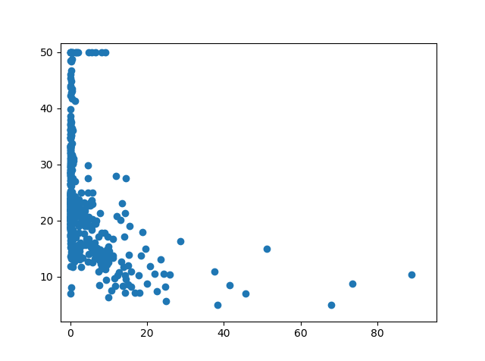
Crime Rate vs Median Price (in 1000$)
median 0.25651
count 73.000000
mean 0.662297
std 0.464178
min 0.029850
25% 0.088730
50% 0.784200
75% 1.002450
max 1.387990

Slide 3
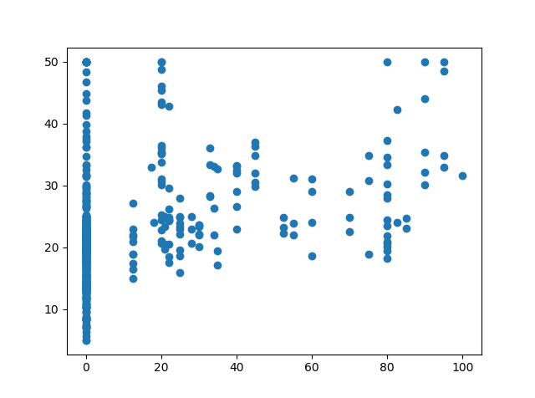
Proportion of Residential Land Zoned for Lots vs Median Price (in 1000$)
count 73.000000
mean 5.287671
std 8.850580
min 0.000000
25% 0.000000
50% 0.000000
75% 12.500000
max 21.000000

Slide 4
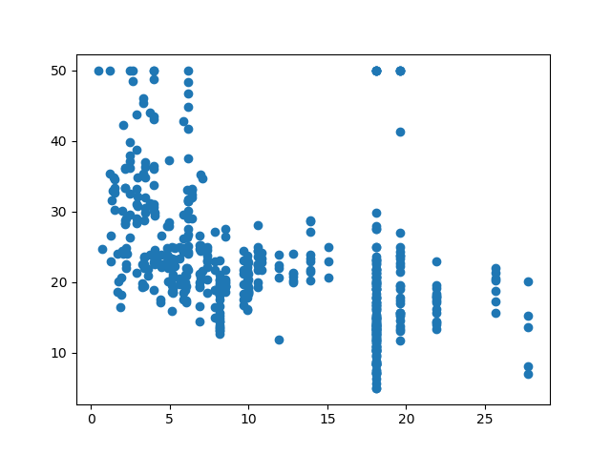
Proportion of Non-Retail Business acres vs Median Price (in 1000$)
median 9.69
count 73.000000
mean 7.320548
std 1.368524
min 2.180000
25% 5.960000
50% 8.140000
75% 8.140000
max 8.140000

Slide 5
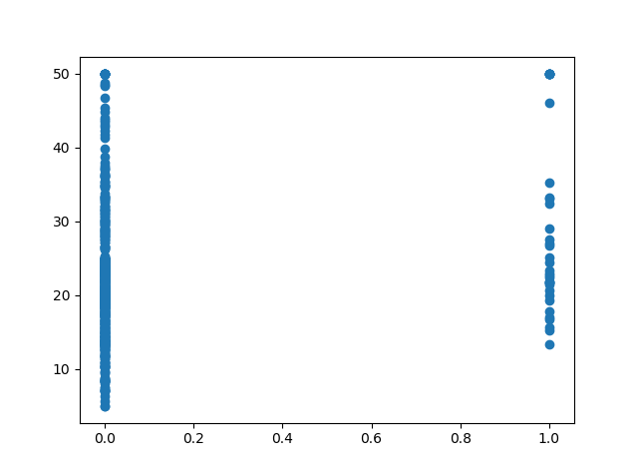
Charles River Dummy Variable vs Median Price (in 1000$)
count 73.0
mean 0.0
std 0.0
min 0.0
25% 0.0
50% 0.0
75% 0.0
max 0.0

Slide 6
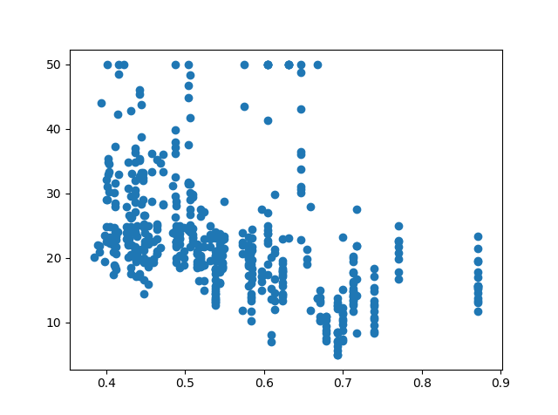
Nitric Oxide Concentration vs Median Price (in 1000$)
median 0.538
count 73.000000
mean 0.509808
std 0.042756
min 0.439000
25% 0.458000
50% 0.538000
75% 0.538000
max 0.538000

Slide 7
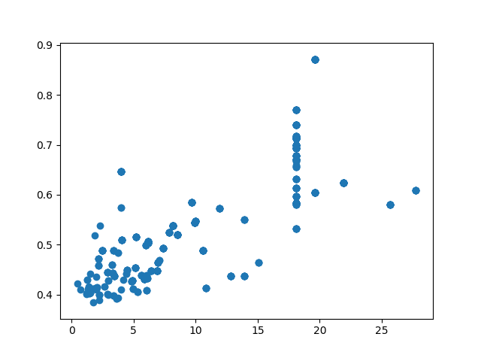
Industries vs Nitric Oxide

Slide 8
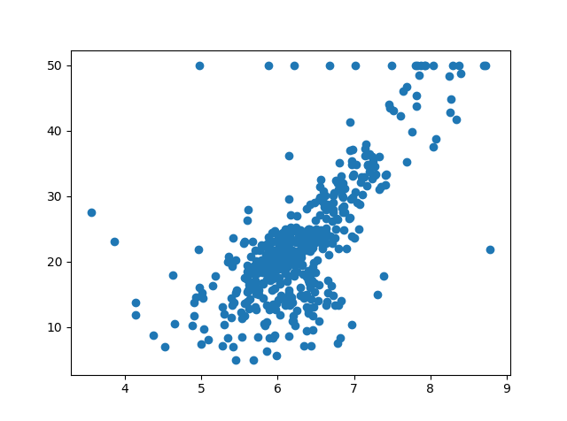
Average No. of Rooms vs Median Price (in 1000$)
median 6.2085
count 73.000000
mean 5.926466
std 0.249255
min 5.456000
25% 5.813000
50% 5.963000
75% 6.009000
max 6.674000

Slide 9
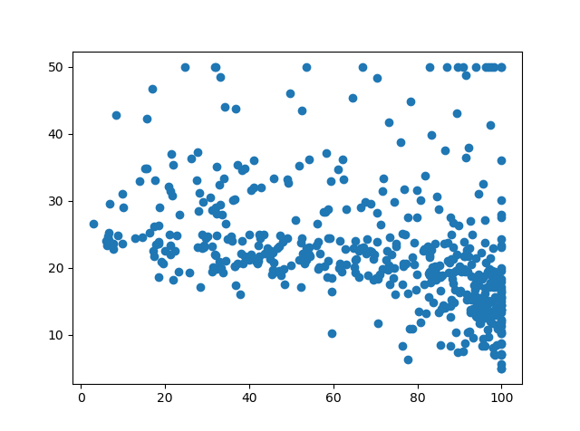
Proportion of Owner Occupied Units Built Before 1940 vs Median Price (in 1000$)
median 77.5
count 73.000000
mean 73.039726
std 22.616806
min 29.300000
25% 45.700000
50% 85.700000
75% 91.700000
max 100.000000

Slide 10
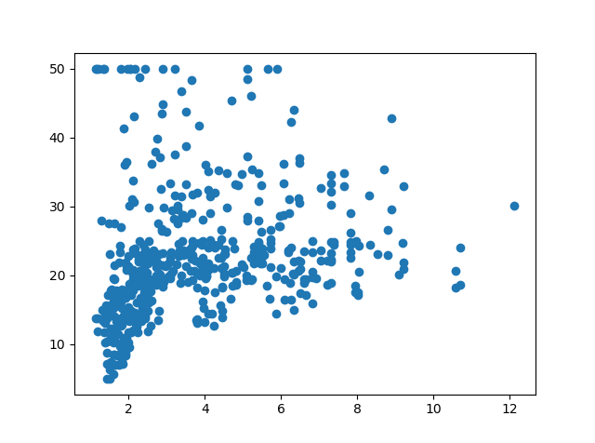
Weighted Distance to Employment Centers vs Median Price (in 1000$)
median 3.207449
count 73.000000
mean 4.913597
std 1.168396
min 3.377900
25% 3.990000
50% 4.454600
75% 6.062200
max 6.814700

Slide 11
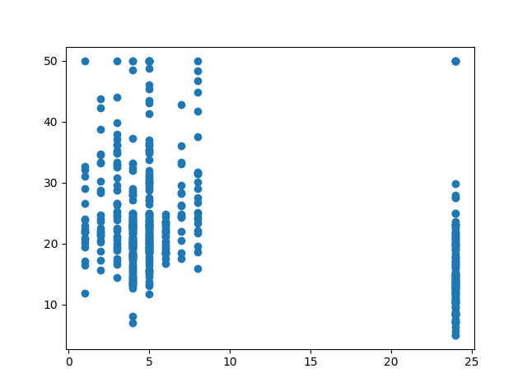
Index of Accessibility to Radial Highways vs Median Price (in 1000$)
median 5.0
count 73.000000
mean 4.027397
std 0.371656
min 3.000000
25% 4.000000
50% 4.000000
75% 4.000000
max 5.000000

Slide 12
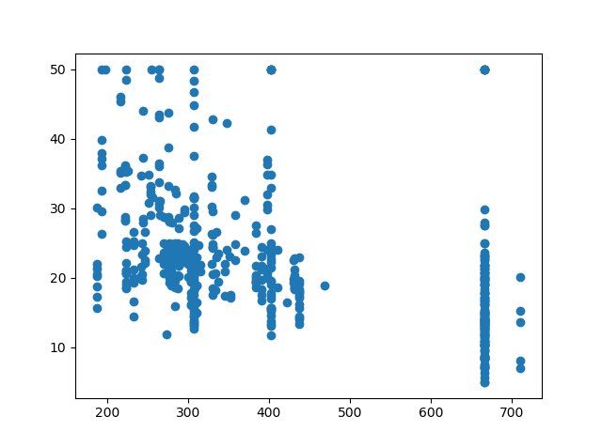
Full Value Property Tax vs Median Price (in 1000$)
median 330.0
count 73.000000
mean 288.068493
std 30.369634
min 222.000000
25% 243.000000
50% 307.000000
75% 307.000000
max 311.000000

Slide 13
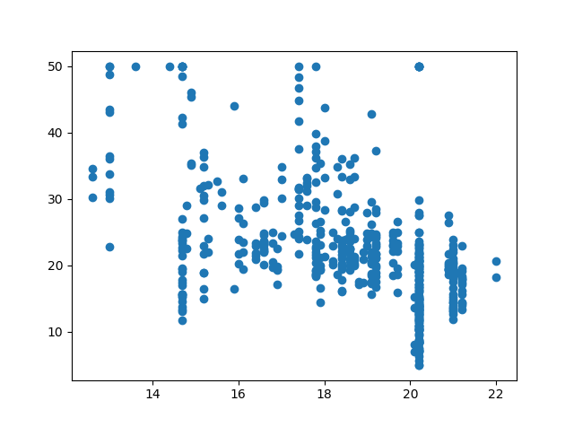
Pupil Teacher Ratio vs Median Price (in 1000$)
median 19.05
count 73.000000
mean 19.564384
std 2.050161
min 15.200000
25% 16.800000
50% 21.000000
75% 21.000000
max 21.000000

Slide 14
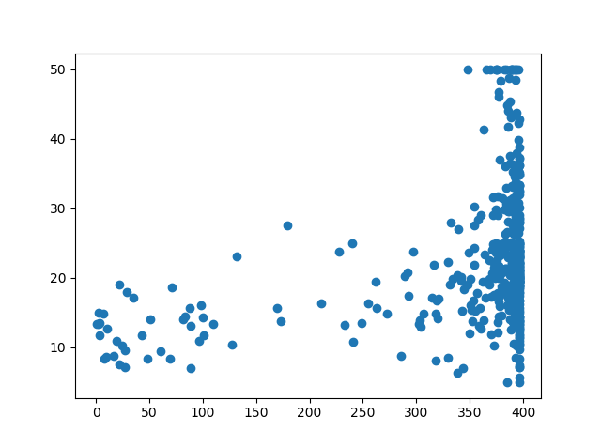
Proportions of Blacks vs Median Price (in 1000$)
median 391.44
count 73.000000
mean 374.737260
std 39.723912
min 232.600000
25% 376.730000
50% 394.330000
75% 395.560000
max 396.900000

Slide 15
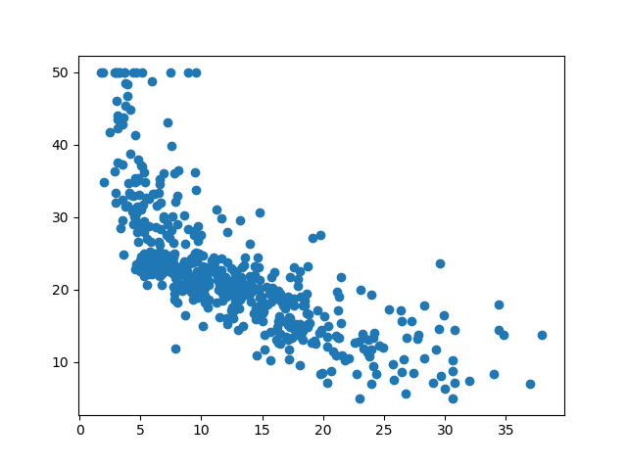
Percentage Lower Status of Population vs Median Price (in 1000$)
median 11.36
count 73.000000
mean 15.053288
std 4.442429
min 5.210000
25% 13.270000
50% 13.830000
75% 18.720000
max 27.710000

Slide 16
Thank You!

